Slide 1
WATERSHEDS MAPPING &
DELINEATION
USING ArcGIS
By RAPHAEL MUSSA

Slide 2
WATERSHEDS
definition
A watershed represents a contiguous geographical area that drains to an outlet. As an example, makutupora watershed.
What does it mean when we say contiguous, we mean Sharing a common border, it means water shades are connected by their borders.
Watersheds always has deferent shapes and sizes.
It is characterized by its elevation and reliefs.
The watershed has two sides.
  Lowland
  Upland

Slide 3
Lowlands or discharge area, and uplands or higher elevated areas
Areas near the drainage outlet are at a lower elevation and referred to as discharge areas. Or lowland areas
while areas on the other end of the watershed are referred to as upland areas and are at higher elevations.

Slide 4
Watershed loci.
The watershed loci,
is a locus of points along the margin that divide the land parcel into two adjacent watersheds and are also at higher elevations than the drainage point.
Therefore, water moves along the watershed from upland areas and along the watershed boundaries toward the drainage point or the outlet of the watershed.

Slide 5
Watershed diagram…
in
out

Slide 6
Water circulation within a watershed
Any rain falling within the contributing drainage area of the watershed will end up at the discharge point. Or may be stored within the watershed or removed by some other natural process such as evapotranspiration and evaporation.
The region bellow the watershed where all pores are saturated is called the saturated zone.
The saturated zone is called an aquifer when the sufficient amount of water can be drawn from it for human uses.
The region between the land surface and the water table is called the vadose zone. Actually The vadose zone pores are partially field with water. Most of the plants depends on this zone

Slide 7
Water circulation within a watershed cont...
When the soil surface is not saturated, water can penetrate into the subsurface and the process is referred to as infiltration. Actually portion of the infiltrated water is stored in the soil, and some of the water is lost to the atmosphere via evapotranspiration and evaporation.
A small portion of the rainfall water entering the subsurface will flow laterally and exit at the drainage point, and this discharge is referred to as the interflow.
Recharge is the process by which water enters the aquifer.
A portion of this recharged water drains out at the watershed discharge point and is referred to as the baseflow.

Slide 8
Water circulation within a watershed cont...
And some water is extracted from the aquifer by humans for agricultural, industrial, and municipal uses

Slide 9
WATERSHEDS MAPPING PROCIDEURES
Required to have computer with sufficient processor and ArcGIS software

Slide 10
DATA SOURCE AND DATA TYPES
Shapefile of the area of interest.
Actually it takes a very large amount of time to deal with the digital elevation of the whole Tanzania in one action, but it can be done separately in specific area(AOI).
Hence you need to obtain the shapefile of the area of interest
The shapefile will show you the limits of the area to be processed

Slide 11
DATA SOURCES AND DATA TYPES
Digital elevation model(DEM)
Now we are at the point to realize that water moves from higher elevations (higher potential energy) to areas of lower elevations (lower potential energy) on the surface of the watershed.
And the geographic relief or elevation changes within a watershed cause water to flow within the watershed during rainfall events.
The digital elevation models are topographic data which store the elevation information associated with the point ( x, y ) on the earths surface.

Slide 12
DEM CONT….
The elevation data can be
Continuous elevation data
x and y vary continuously within the domain.
Discrete elevation data
elevation is presented only at a finite number of x and y points.

Slide 13
DEM CONT…
Importance of DEM in watershed mapping and delineation.
Topography or elevation data is therefore important for two reasons.
to delineate the watershed boundaries corresponding to a discharge point.
to understand surface runoff processes.

Slide 14
SOFTWARE PROCIDURES
1st Open your ArcMap software and add your data (DEM) then overlay it with the shapefile of your AOI.

Slide 15
SOFTWARE PROCIDURES
2nd Create environment.
here what you need is to create the working environment, the database which you will be saving all your works, make sure you give it a name position/location in your drive which is easier for you to remember.
Procedures to create working environment.
Go to geoprocessing tool. In a toolbar of ArcMap > select environments > select workspace dropdown arrow.

Slide 16
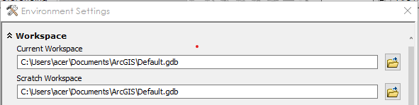
SOFTWARE PROCIDURES
You will see the two option
Current workspace
Scratch workspace
current workspace is used for all output data which their names are generated by you
Scratch stands for all output names which are auto generated but when you modify it, it will be saved in current.

Slide 17
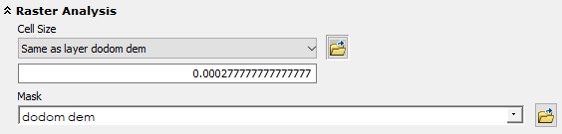
SOFTWARE PROCIDURES
After you have selected the default locations for your output data.
Within the environment tool extend the raster analysis by clicking the drop down arrows
Choose the cell size to be the same as your input digital elevation model layer. For me my input layer was “dodom dem”

Slide 18
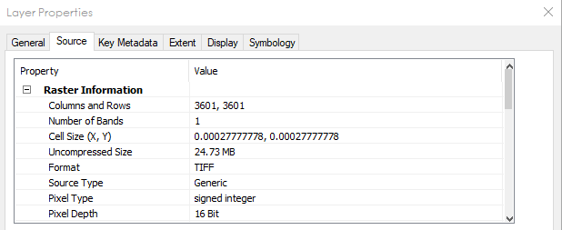
SOFTWARE PROCIDURES
3rd check the data properties.
By right click the input layer “dodom dem” > properties > source.

Slide 19
SOFTWARE PROCIDURES
If there is no projection follow these steps.
Open Toolbox → Data Management Tools→ Projections and Transformations → Define Projection . You’ll have to know how the projection of your raster should be defined. This information can be found in the metadata information for the raster.

Slide 20
SOFTWARE PROCIDURES
4th elevational correction of dem data.
It’s important to be sure that all elevation values are reasonable. One possibility is that a group of unusually high values represents the ocean mask value in the original image while we are aware that all elevation data are measured from the ocean as origin or zero elevation.
Using the Identify tool, click around on your area to see if this is a reasonable assumption. But for the area which are nearby the ocean you can click those area to see if they have zero if they don’t follow this steps

Slide 21
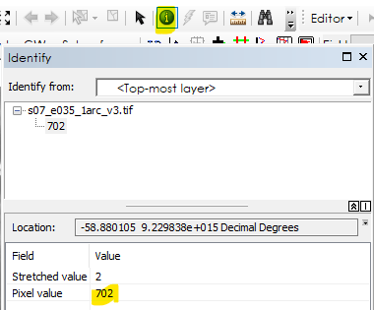
SOFTWARE PROCIDURES
Use identifier to select the value of
the pixel elevation. To a point of known
elevation example ocean. Elevation = 0.
If you found the elevation to be greater
than zero for ocean it means
the elevation data are incorrect

Slide 22
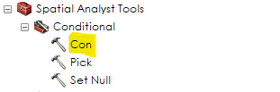
SOFTWARE PROCIDURES
How to correct the elevational data in DEM?
By using a con tool. Through the following procedures.
To make sure that this value does not create problems during the data creation and analysis processes, you'll use the Con tool to change it to 0 (i.e., sea level).
• Expand the Conditional toolset in the Spatial Analyst Tools toolbox. Open the Con tool.
• The Con tool allows you to change the values of cells based on a conditional statement. For example, if the ocean is currently represented by a value of 702, it will be replaced with a value of 0. Otherwise, the cell will retain its elevation value.

Slide 23
SOFTWARE PROCIDURES
Fill out the dialog box as follows:
For Input conditional raster, choose dodom_dem.
For Expression, click the Query Builder button. In the Query Builder, build the following statement:
Value = 702
Click OK.
For Input constant value, enter 0.
For Input false raster choose dodom_dem.
Name the output raster corrected_dodom_dem. (The path should default to your Scratch folder.) Click OK to run the Con tool.

Slide 24
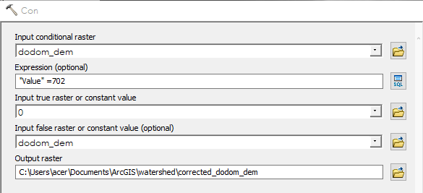
SOFTWARE PROCIDURES
When the new layer is added, turn off dodom_dem and Corrected_dodom_dem will now be the elevation DEM you work with.

Slide 25
SOFTWARE PROCIDURES
5th create the flow direction layer.
This is first step in creating watershed.
Your first step in creating the watersheds is to set flow direction for the elevation raster. Determining the direction of flow through each cell is always the first step in surface hydrology analysis, because all the other hydrology tools need this information to work.
Note the flow direction layer determines the direction of flow through each cell. The Flow Direction tool finds the flow direction for a cell by comparing its elevation to those of its neighbors. The output is a code that identifies the neighbor into which water will flow.

Slide 26
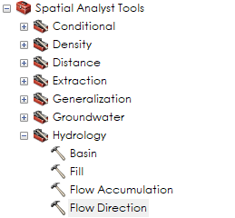
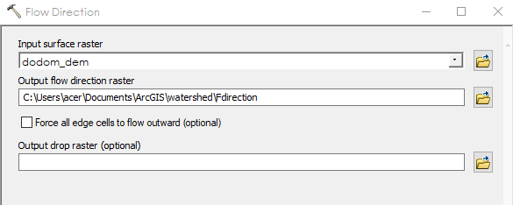
SOFTWARE PROCIDURES
Follow these extensions in arc toolbox……………………………………..>
In put raste= corrected_dodom_dem.
Outtput raster give the name of the output Mine is “fdirection”
leave the check box unchecked. Then ok!!!

Slide 27
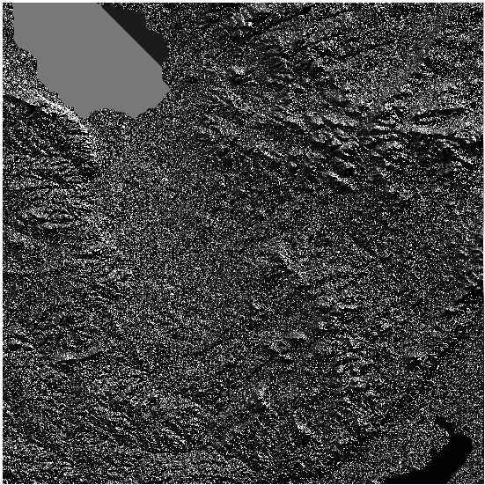
SOFTWARE PROCIDURES
Results of flow direction!!!!!
Don’t get mad. Because of
That appearance proceed…

Slide 28
SOFTWARE PROCIDURES
6th locate sinks.
A sink is a group of one or more cells that have lower elevations than all the surrounding cells. When water flows into a sink, it cannot flow out and contribute to the flow downstream; therefore, flow direction cannot be assigned one of the eight valid values in a flow direction grid.
Actually sinks in elevation data are most commonly due to errors in the data. These errors are often due to sampling effects and the rounding of elevations to integer numbers.

Slide 29
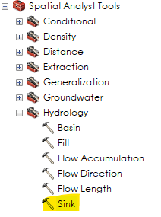
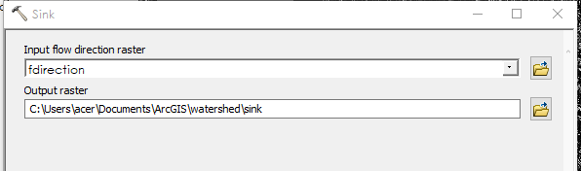
SOFTWARE PROCIDURES
Follow these steps to locate sinks
Input flow direction raster = fdirection
Output raster you need to specify the location of the sink layer
Mine is “sink1”

Slide 30
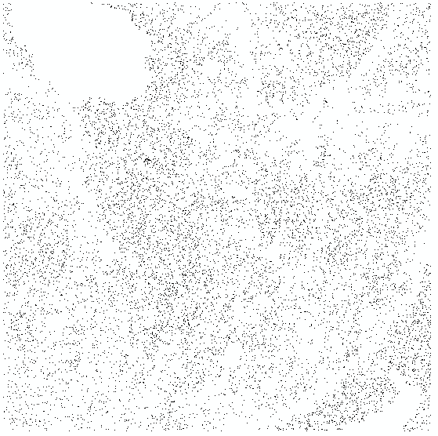
SOFTWARE PROCIDURES
The output will be….
When you uncheck the other layers..

Slide 31
SOFTWARE PROCIDURES
7th fill those sinks you have located.
The Fill tool finds the sinks (their elevation is lower than all the surrounding cells) and then "fills" them to the elevation of their lowest neighbor. And since the sinks have been located in the previous steps. We are going to fill them. Follow these steps

Slide 32
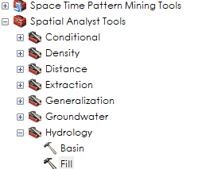
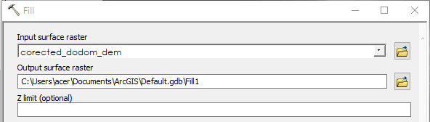
SOFTWARE PROCIDURES
Follow this extension
Input surface raster use the corrected_dodom_dem
The name of the filled layer should be specified
Mine is fill1

Slide 33
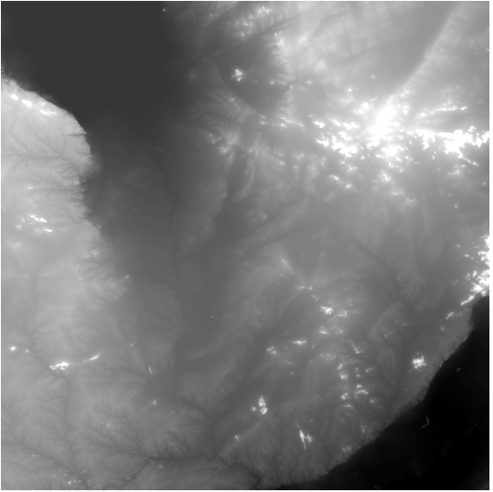
SOFTWARE PROCIDURES
The output will be…

Slide 34
SOFTWARE PROCIDURES
8th set up flow direction for filled layer
Now you'll need to determine the direction of flow for the new elevation raster.
• Open the Flow Direction tool.
• Choose fill1 for the input raster.
• Name the output raster mine is flow_dir_fill
• Click OK.

Slide 35
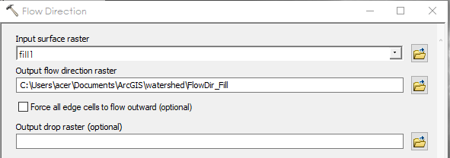
SOFTWARE PROCIDURES

Slide 36
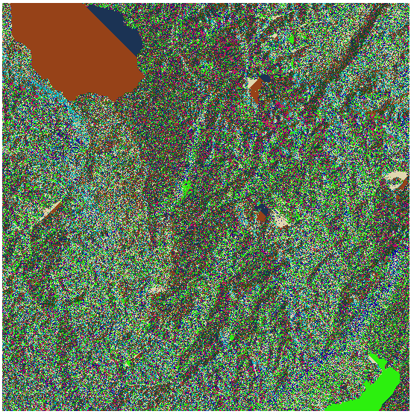
SOFTWARE PROCIDURES
The output will be

Slide 37
LAST STEP
CREATE THE WATERSHADES

Slide 38
LAST STEP
Now you're ready to create the watersheds.
From the Hydrology toolset, double-click Basin.
Why use the Basin tool instead of the Watershed tool?
ArcGIS includes two surface hydrology tools that create watersheds for pour points—Basin and Watershed. Pour point data (either vector or raster) represent locations above which the contributing area will be determined.
The Basin tool finds its own pour points and creates watersheds for the whole map.
The Watershed tool creates watersheds for the pour points that you provide.

Slide 39
LAST STEP
Input flow_dir_fill as input.
Specify the output. Mine is watersheds

Slide 40
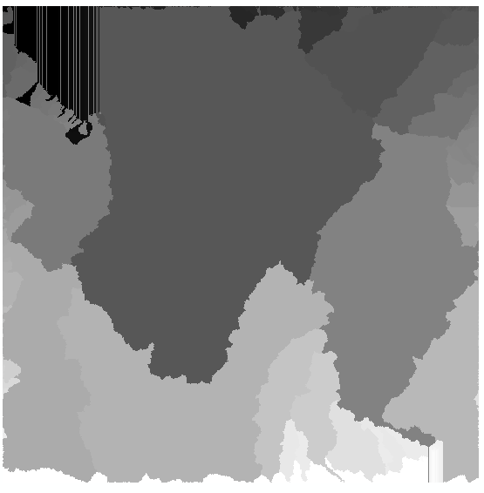
LAST STEP
This is the final output
YOU CAN CONVERT THE WATERSHEDS TO SHAPEFILES
Find me raphamussa1@gmail.com
Or 0788924800

Slide 41
THANK YOU

